Slide 1
Server: 129.74.246.122
Login: daspos
Password: daspos1

Slide 2
Quick start: bertini software
mkdir -p /tmp/alex/umbrella_cache
cd /tmp/alex
wget -O bertini.umbrella \
https://curate.nd.edu/downloads/b2773t9694n
umbrella --spec bertini.umbrella \
--localdir umbrella_cache/ \
--sandbox_mode docker \
run

Slide 3
Umbrella
Tracking execution environment
Umbrella Specification
Creating execution environment
Umbrella Execution Engine
Preserving execution environment
Umbrella Archiver

Slide 4
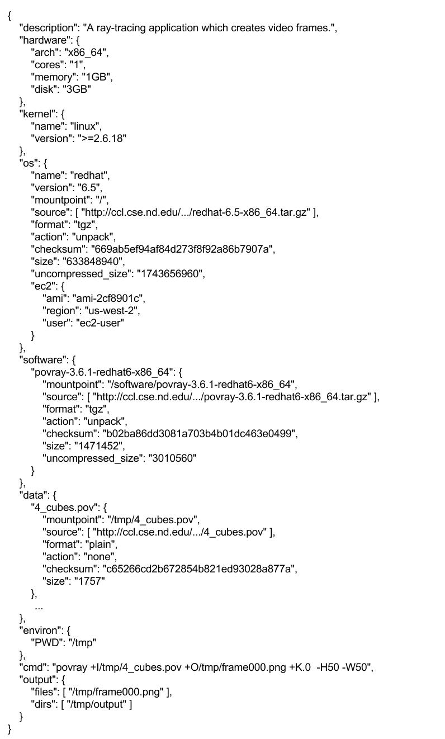
Umbrella Specification
Sections:
Hardware
Kernel
OS
Software
Data
Environment variables
CMD
Output

Slide 5
Resource URLs Supported by Umbrella
Resource | Example URL
Local Filesystem | /home/dthain/data/input
HTTP | http://www.data.com/data/file1
HTTPS | https://lab.cse.nd.edu/data/hep/file2
Amazon S3 | s3+https://s3.aws.com/…/cubes.pov
Open Science Framework (OSF) | osf+https://files.osf.io/v1/…/7559c3a
Git Repository | git+https://github.com/…/cctools.git
CernVM File System | cvmfs://cvmfs/cms.cern.ch

Slide 6
Umbrella spec example
{
"cmd": "/software/bertini",
"comment": "Bertini",
"data": {
"input": {
"action": "None",
"checksum": "5566c8dc820c2a2744f646abf662e34b",
"format": "plain",
"id": "5566c8dc820c2a2744f646abf662e34b",
"mountpoint": "/tmp/input",
"size": "197",
"source": [
"https://curate.nd.edu/downloads/8w32r496z2g"
]
}
},

Slide 7
Umbrella Execution Engine
Matching degree between
-- the execution node
-- the execution environment specified via
an Umbrella specification
Hardware | Kernel | OS | Sandbox Techniques
Yes | Yes | Yes | Utilize the current OS directly
Yes | Yes | No | OS-level Virtualization Docker, Parrot
Yes/No | No | No | Hardware Virtualization Local: VirtualBox, VMWare Remote: Amazon EC2

Slide 8
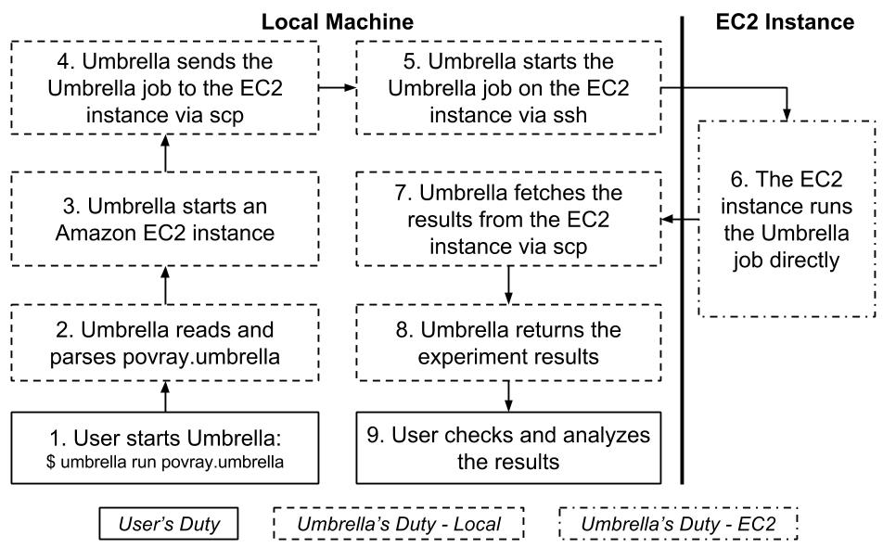
Umbrella EC2 Execution Engine

Slide 9
Example: parrot execution engine
umbrella --spec bertini.umbrella \
--localdir umbrella_cache_parrot/ \
--sandbox_mode parrot \
run

Slide 10
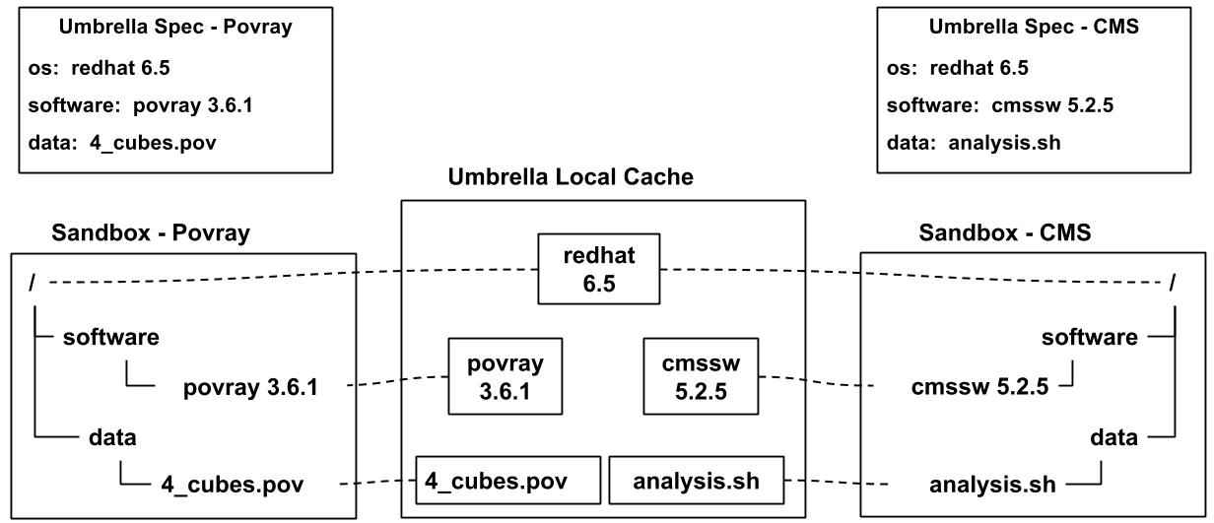
Umbrella Local Cache
OS-level virtualization

Slide 11
[avyushko@stockpile demo1]$ ls /tmp/umbrella_cache/cache
5566c8dc820c2a2744f646abf662e34b c2a2b68f8089209fc2454f3bc242b5d2
902703f016e0f930a870eaf9cb31640b

Slide 12
Build umbrella spec
cd ~/update_spec
umbrella \
--localdir /tmp/umbrella_test/ \
build bertini.umbrella bertini.new.umbrella

Slide 13
"data": {
"input": {
"format": "plain",
"source": [ ”/tmp/spec/input_new"
],
"action": "None",
}
}
"data": {
"input": {
"format": "plain",
"checksum": "5566c8dc820c2a2744f646abf662e34b“,
"source": [ ”/tmp/spec/input_new"
],
"action": "None",
"id": "5566c8dc820c2a2744f646abf662e34b",
"size": "197” }
}

Slide 14
Umbrella Archiver
Two Categories of Unreliable Dependencies:
Local dependencies
Some third-party network dependencies
Allows the user to mark unreliable deps
Uploads the unreliable deps to reliable archive
Amazon S3
OSF storage service
Allows the user to set the access permission of uploaded resources

Slide 15
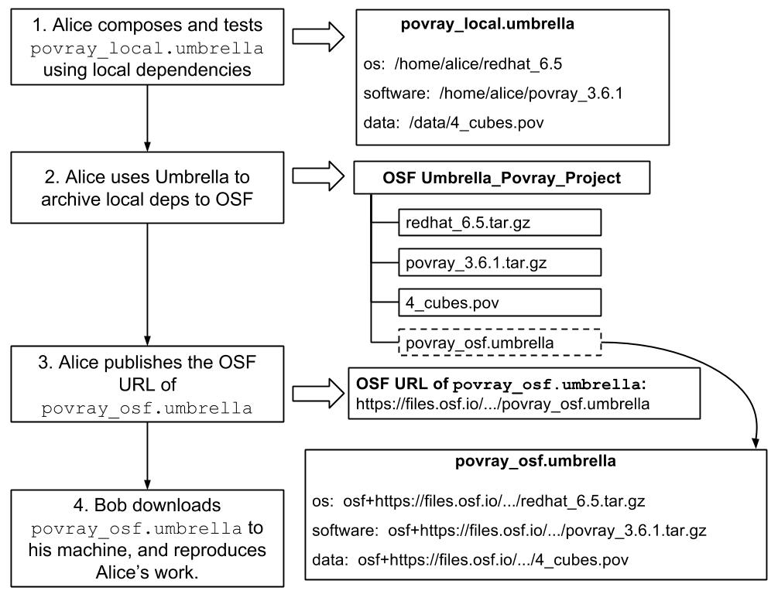
Umbrella + OSF

Slide 16
umbrella --spec bertini.new.umbrella \
--localdir umbrella_osf/ \
--osf_userid=kh4n3 \
--osf_user=avyushko@nd.edu \
--osf_pass=password upload osf proj_bertini public osf.umbrella

Slide 17
"os": {
"name": "CentOS",
"format": "tgz",
"checksum": "902703f016e0f930a870eaf9cb31640b",
"source": [
"osf+https://files.osf.io/v1/resources/6q523/providers/osfstorage/573f29bdb83f6901f2768b29"
],
"version": "6.6",
"uncompressed_size": "212684800",
"id": "902703f016e0f930a870eaf9cb31640b",
"size": "72213624"
},

